Slide 1
SlicerIGT tutorial 2021
brain surgery navigation with live tractography
for 3D Slicer version 4.11.20210226

Slide 2
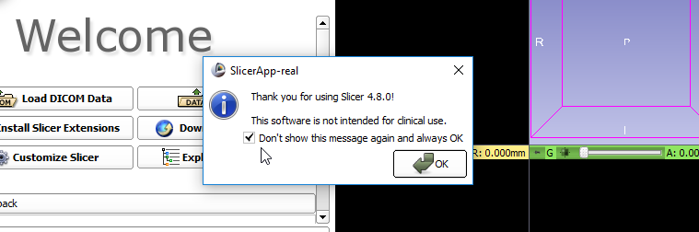
Install Slicer
Visit http://download.slicer.org/
Download Slicer version 4.11.20210226 (blue buttons) for your operating system
Run the downloaded installer
Start up Slicer
1

Slide 3
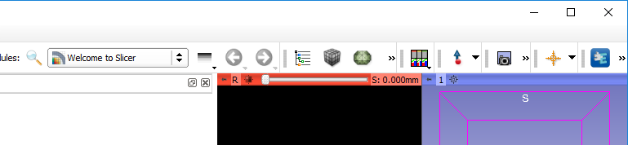
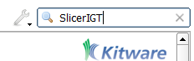
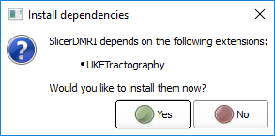
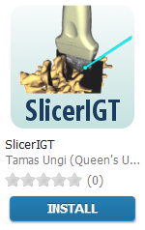
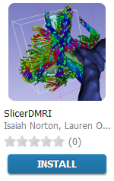
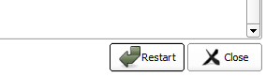
Install Slicer extensions
1. click
2. Find and install these extensions: SlicerIGT, SlicerDMRI
5. click
3. click
4. click
6. click

Slide 4
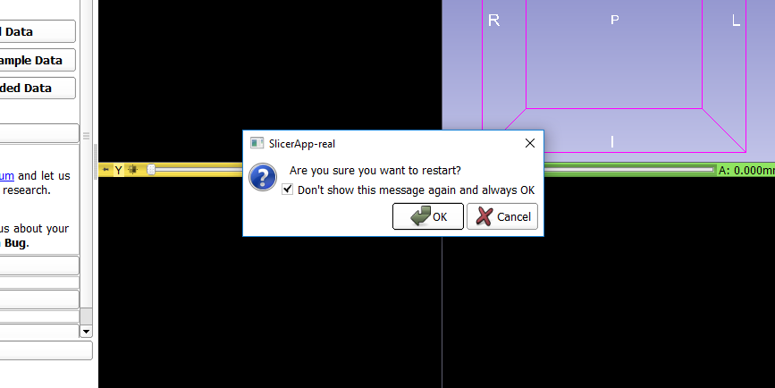
Approve restart of Slicer (if asked)
1. check
2. click

Slide 5
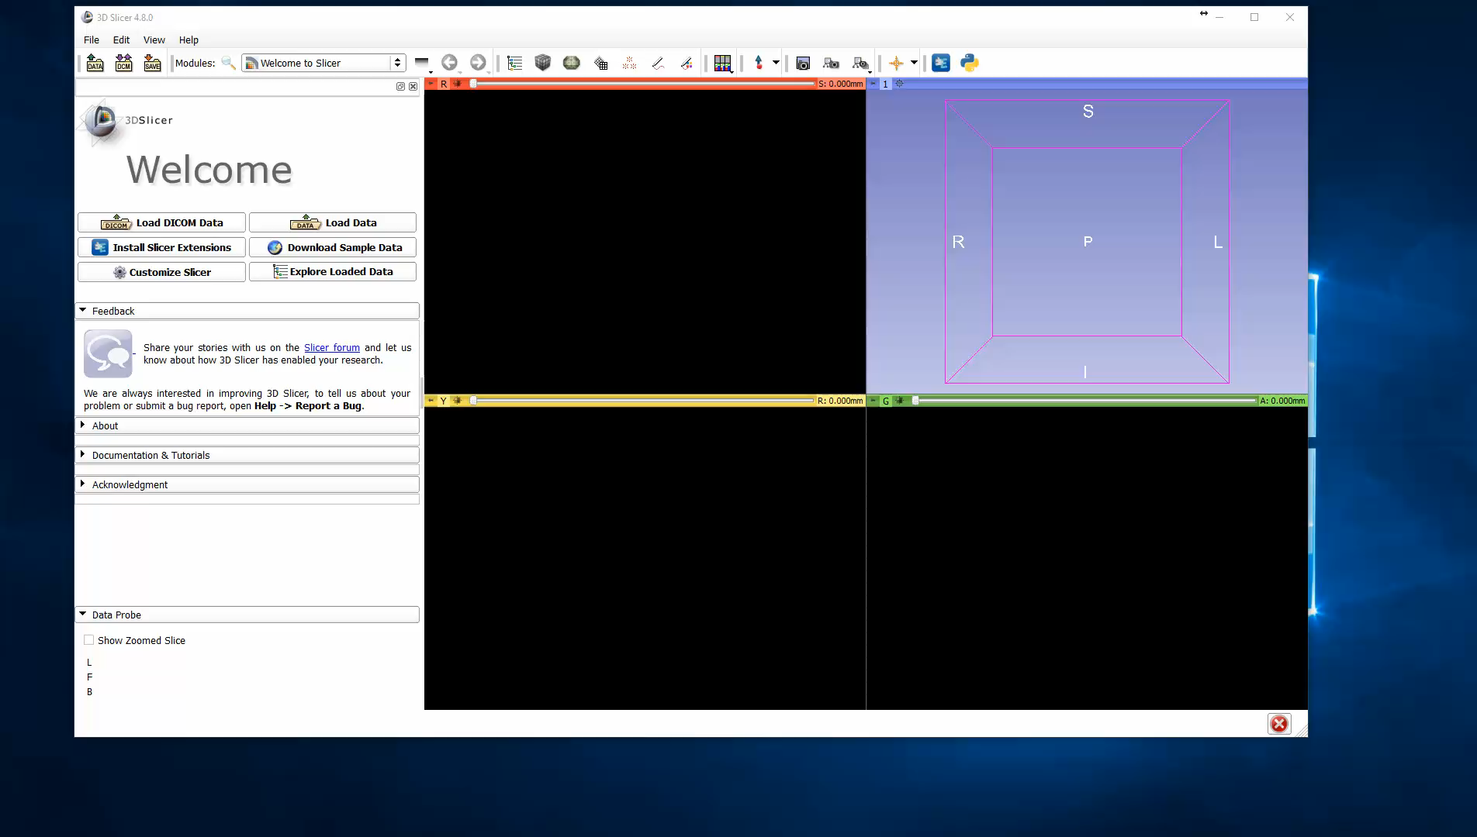
Verify extensions installed

Slide 6
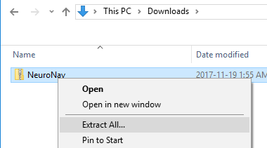
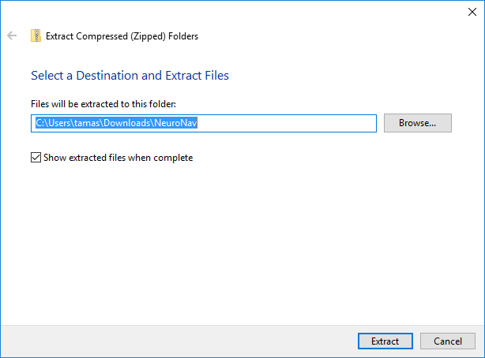
Unzip tutorial data folder
1. click
2. click

Slide 7
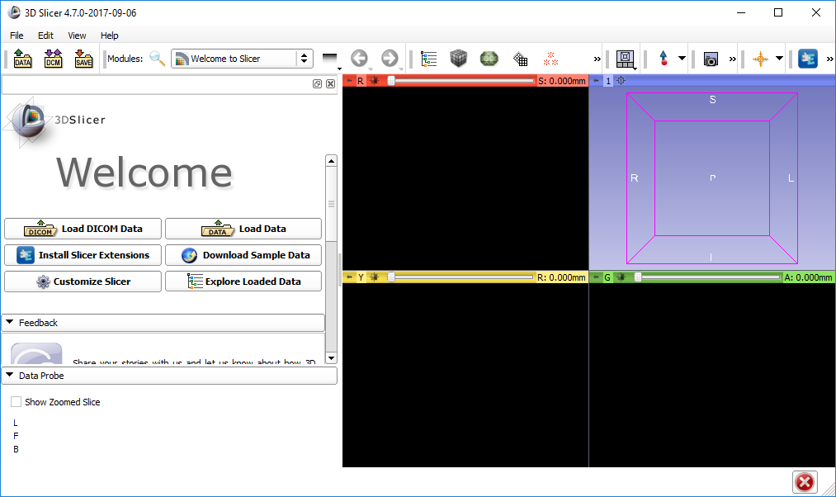
Open dialog

Slide 8
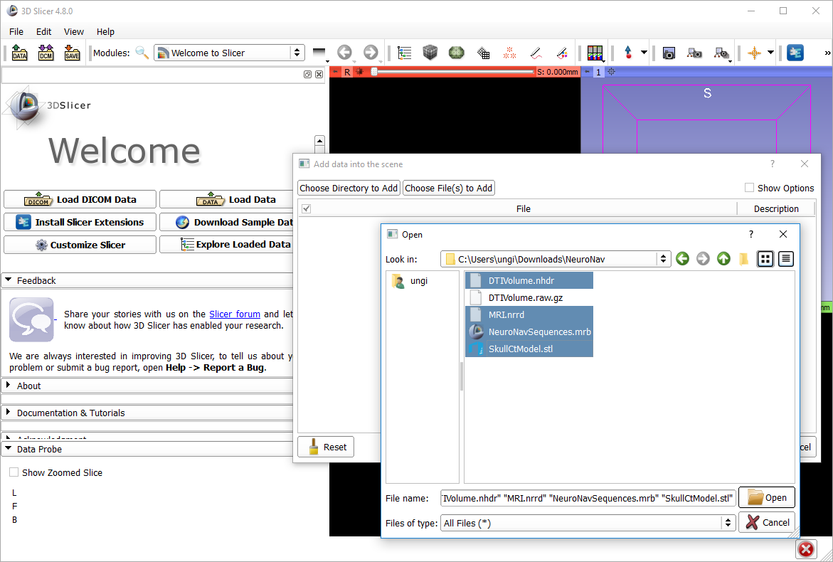
1
2
2
2
2
3

Slide 9
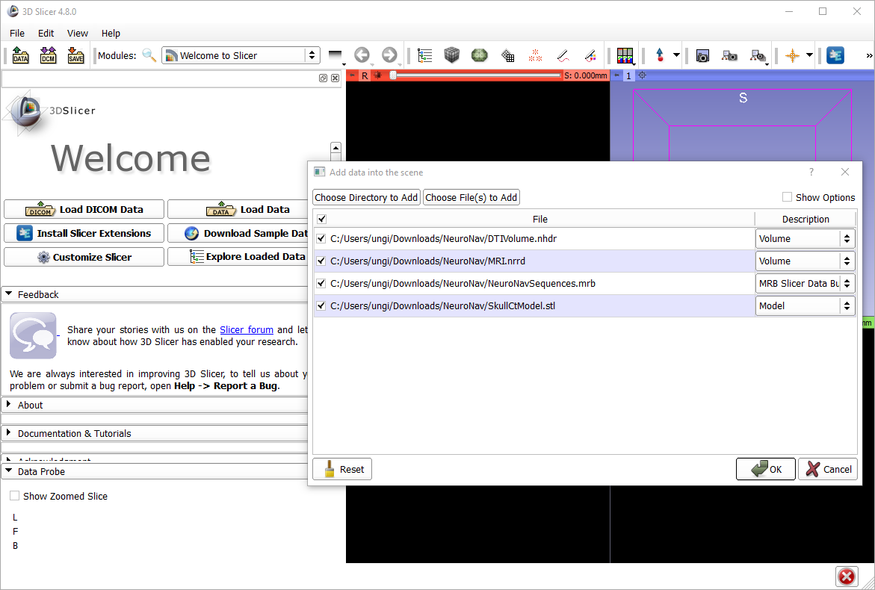
1

Slide 10
About the loaded data
SkullCtModel.stl: Segmentation from CT scan of a plastic skull model
MRI.nrrd: Magnetic resonance image of a person. (not the same one the plastic model was based on)
DTIVolume.nhdr: Diffusion tensor image (from a third person)
NeuroNavSequences.mrb: Time sequences for replaying tool motions
All image volumes are already registered roughly (they more or less overlap, but they come from different patients, so the overlap is not perfect)

Slide 11
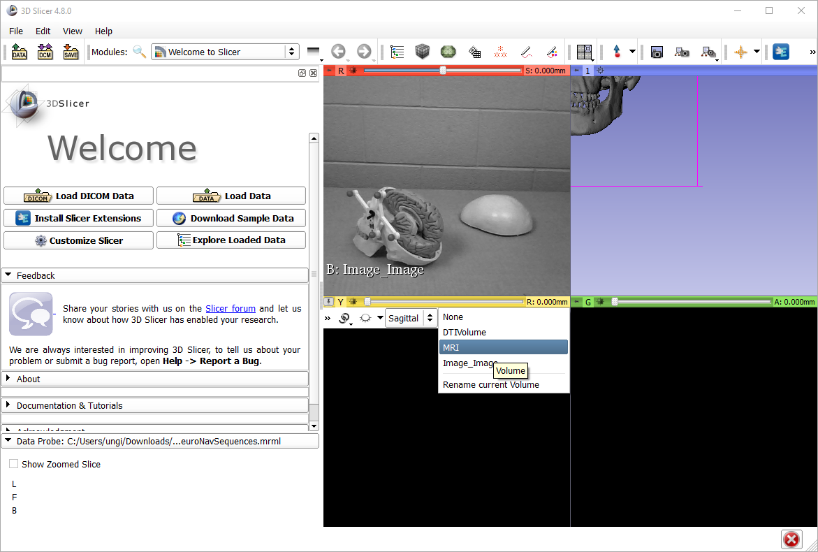
1
2. open selector
3

Slide 12
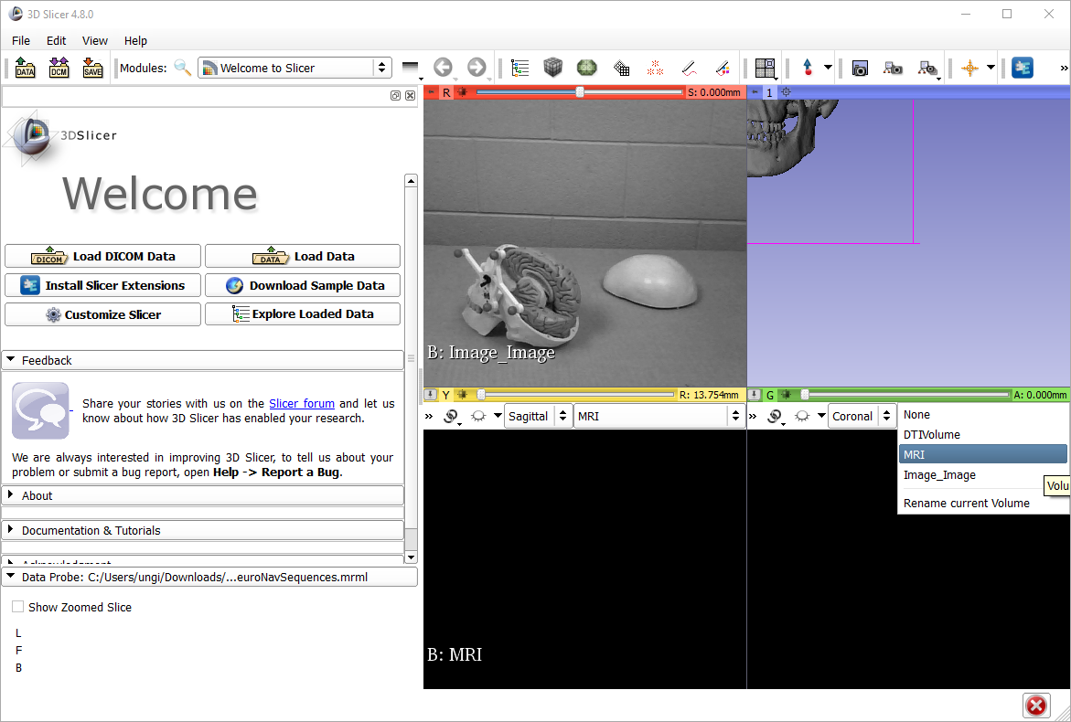
1
2. open selector
3

Slide 13
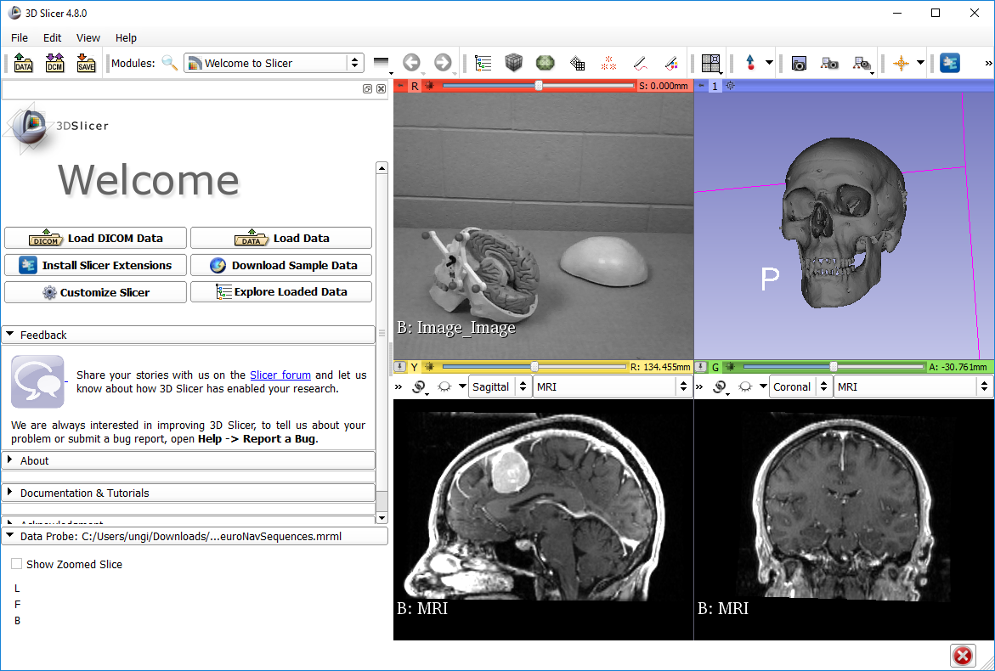
3
1
2

Slide 14
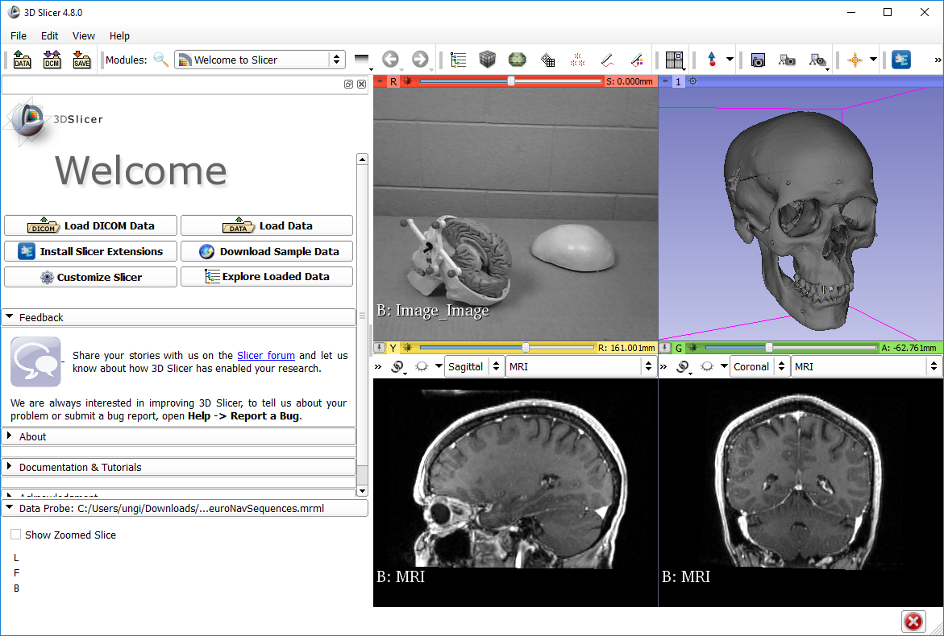
Try 3D interactions
Mouse left button drag – rotations
Mouse wheel – zoom
Mouse middle button drag – panning
Try 2D interactions
Mouse wheel – change slice
Mouse right button drag – zoom
Mouse middle button drag – panning
Mouse left button drag – intensity windowing

Slide 15
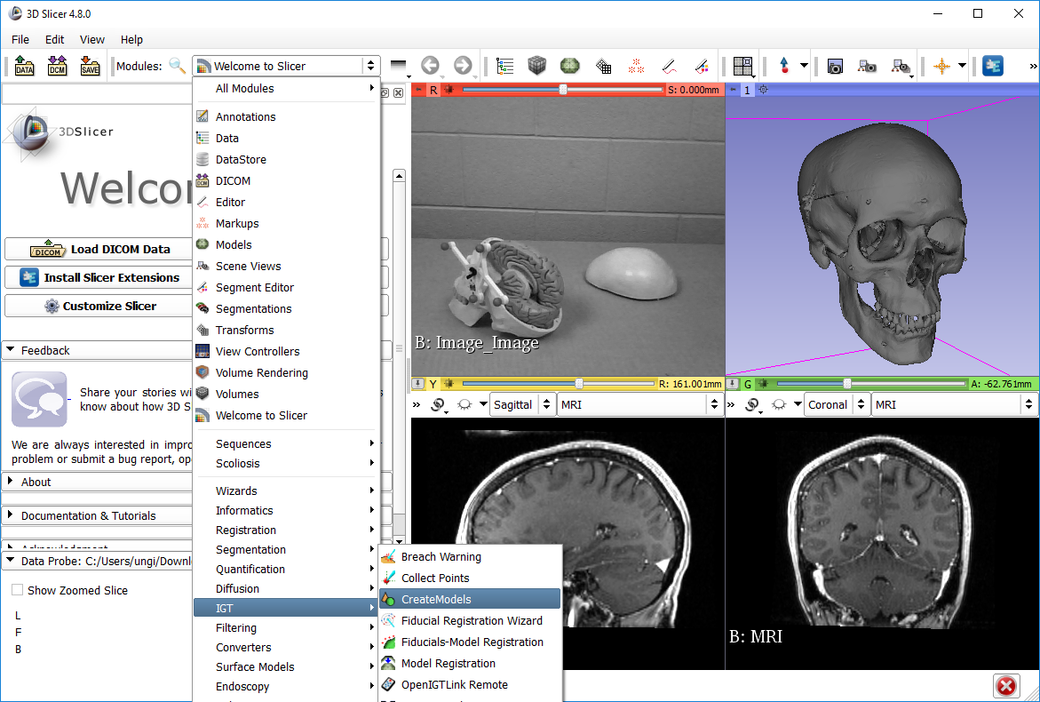
1
2
select

Slide 16
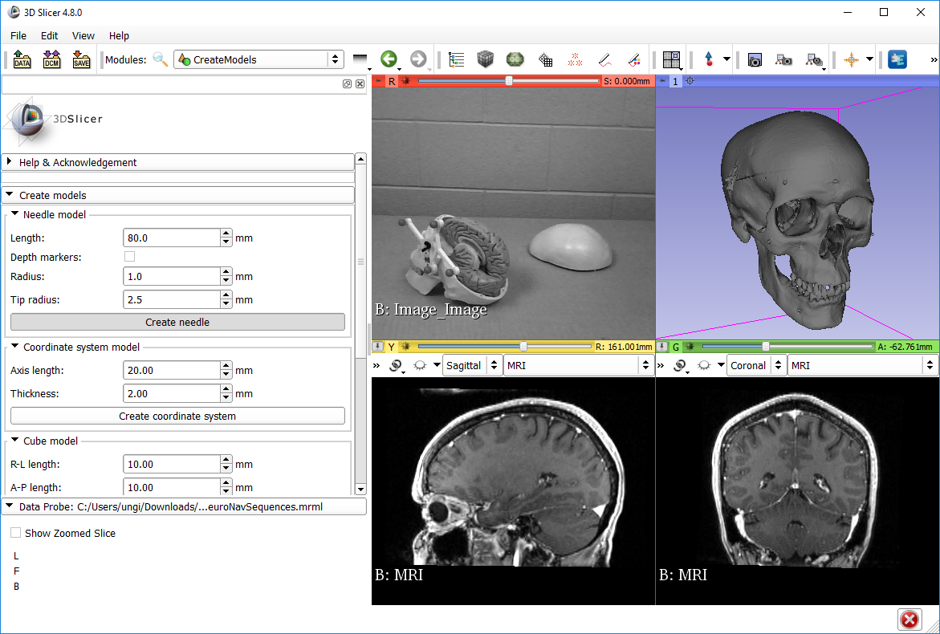
1. see
2. Press once
You won’t see anything when you click, but don’t worry, the needle model is created.

Slide 17
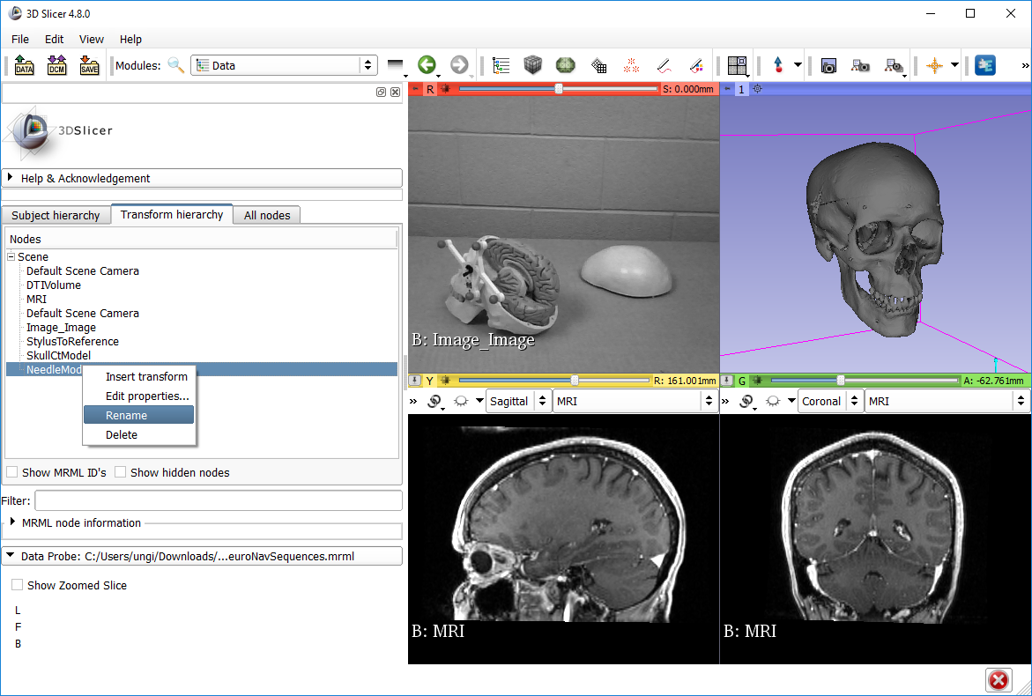
2. see
1
3
4. Right click
5
6. Rename to “StylusTip”

Slide 18
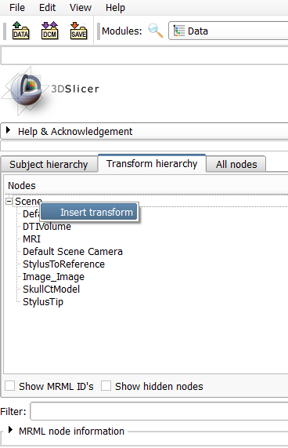
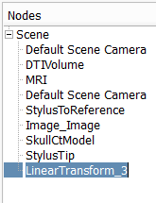
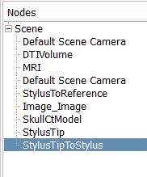
3. Double-click to rename new transform
1. Right-click on Scene
2
4. Name it StylusTipToStylus

Slide 19
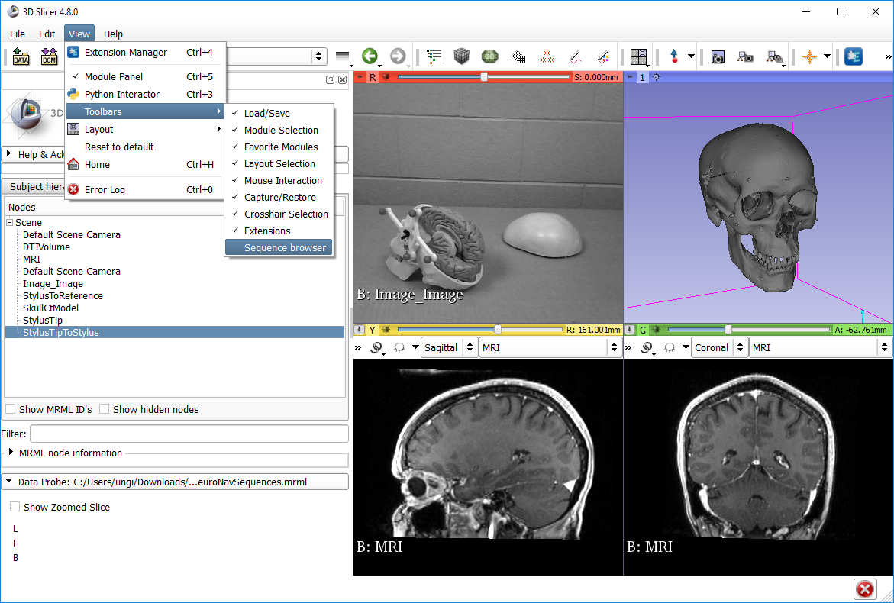
1
2
3

Slide 20
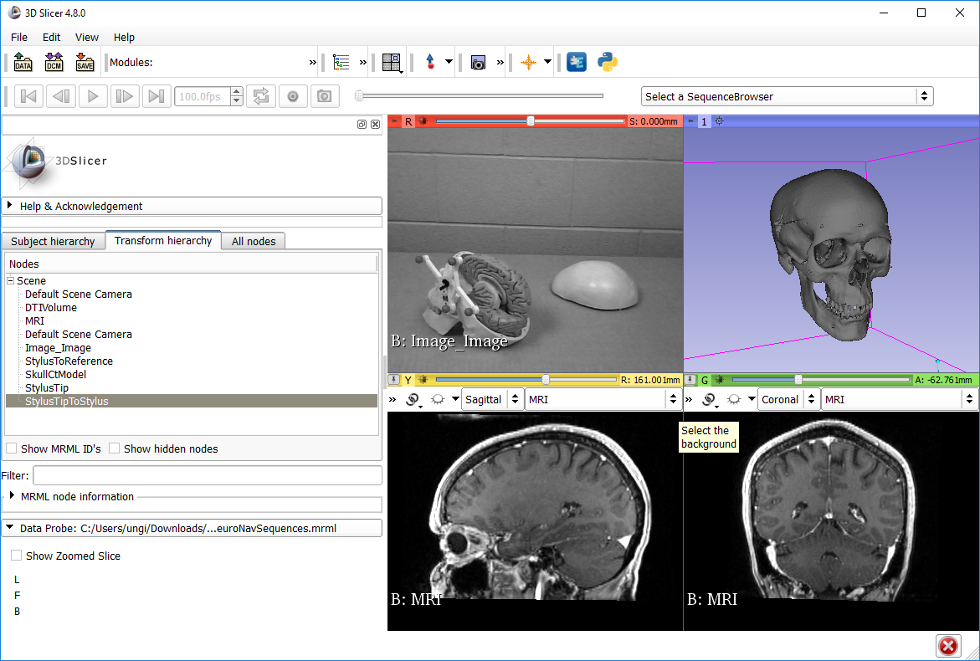
You can drag and drop the position of the toolbar grabbing this grey vertical bar. Putting it in a new line gives it more space.

Slide 21
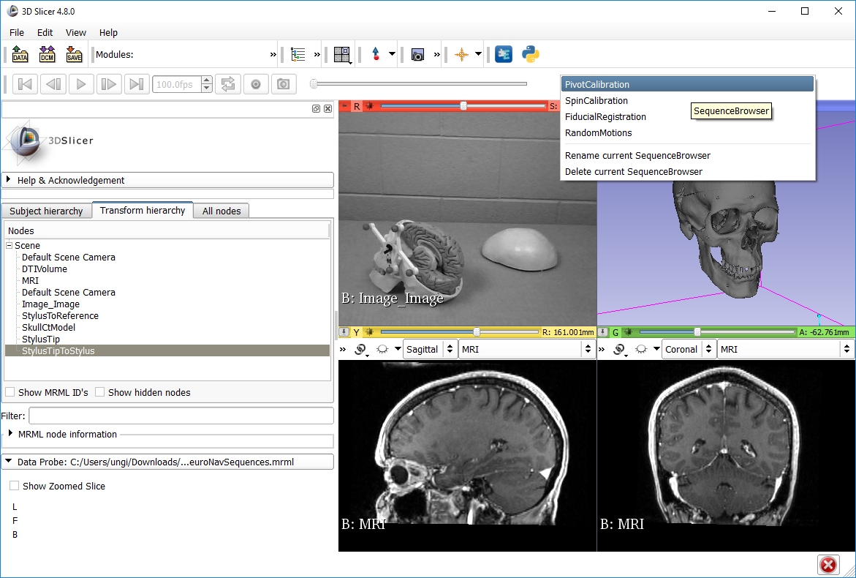
1

Slide 22
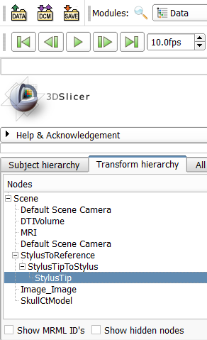
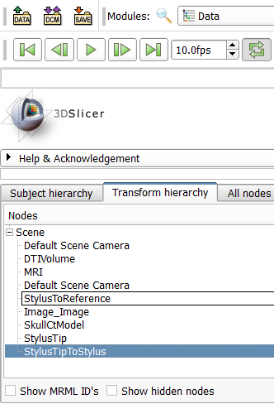
2. Drag and drop until the transform hierarchy looks like this
1. Drag and drop transformable nodes to create transform hierarchy

Slide 23
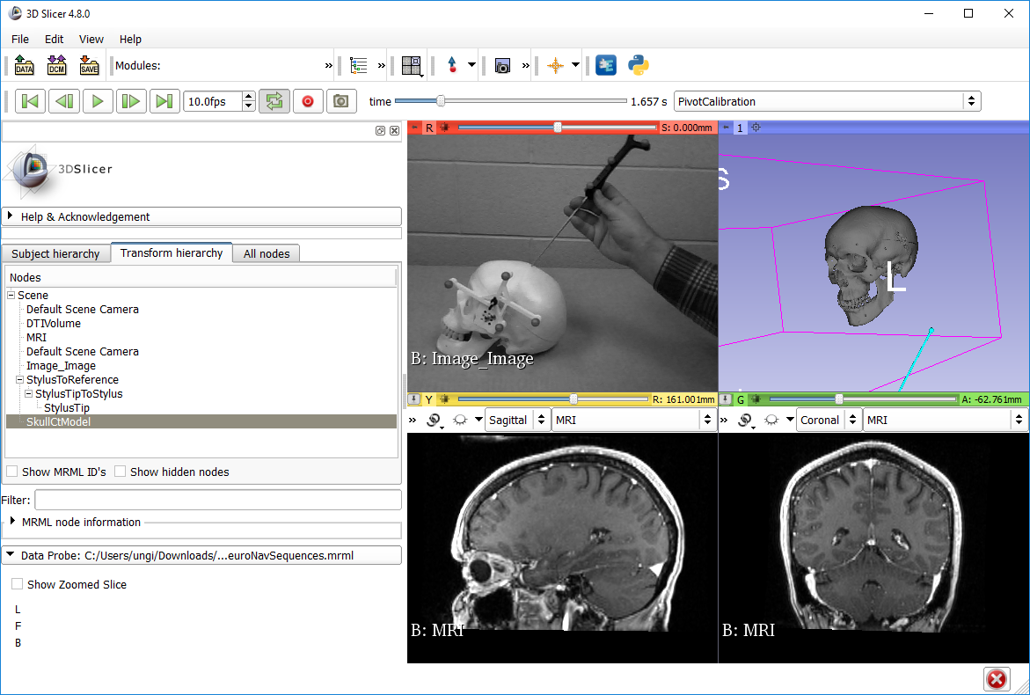
1
2. Zoom out and rotate to see the blue stick (StylusTip) move

Slide 24
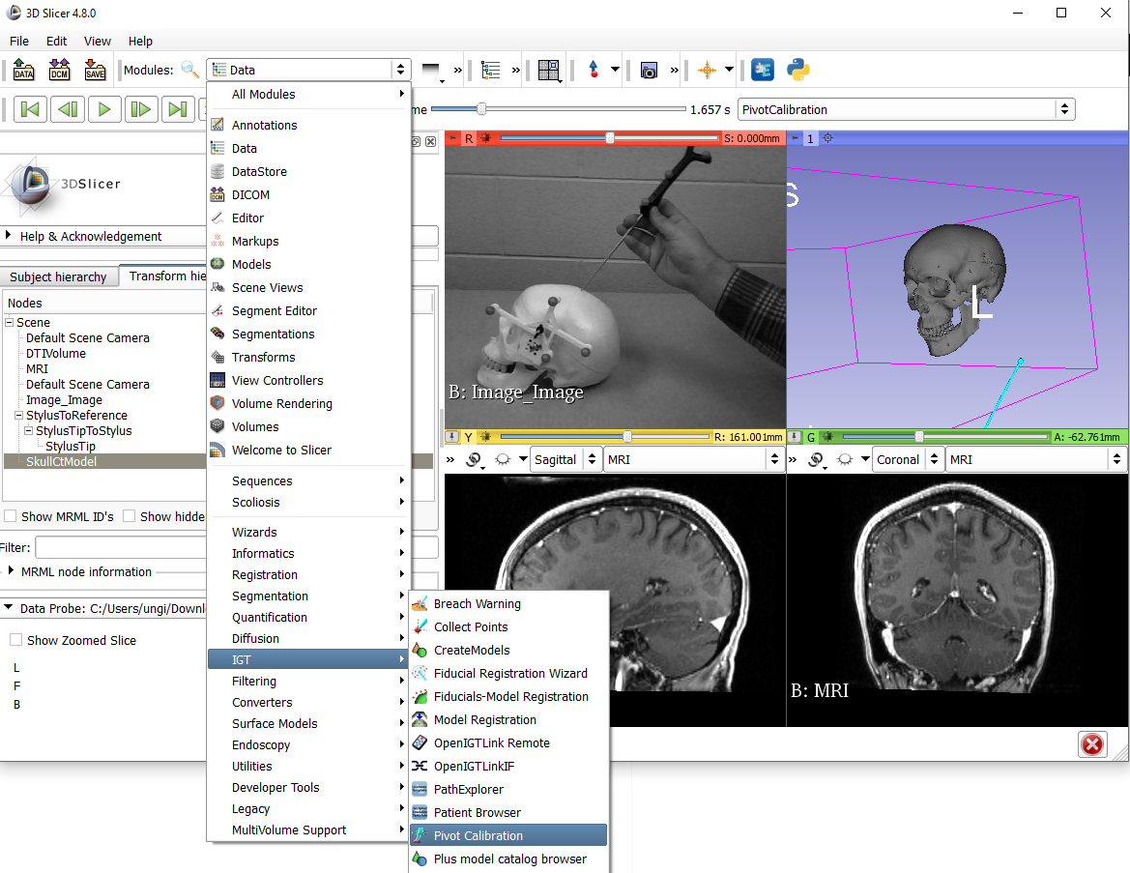
1
2
3. select

Slide 25
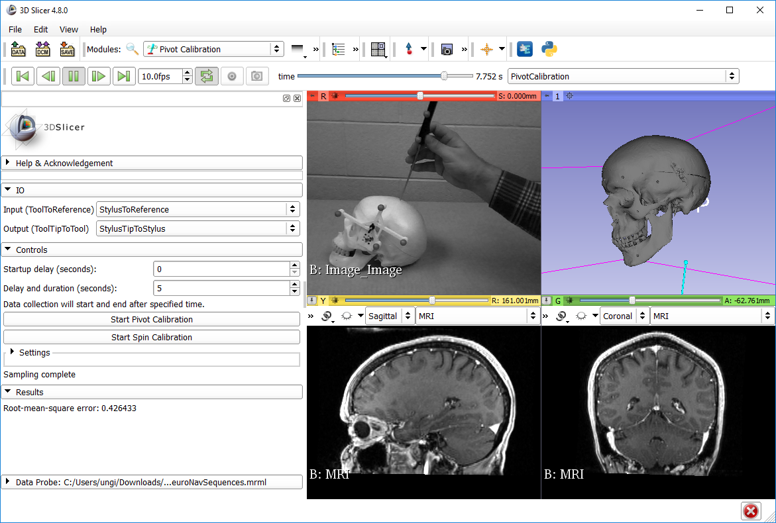
1
2
5. see: tip position should remain roughly stable
3. (optional)
4. then wait 5 seconds
7. Check RMSE
6. collapse (this tab is not needed now)

Slide 26
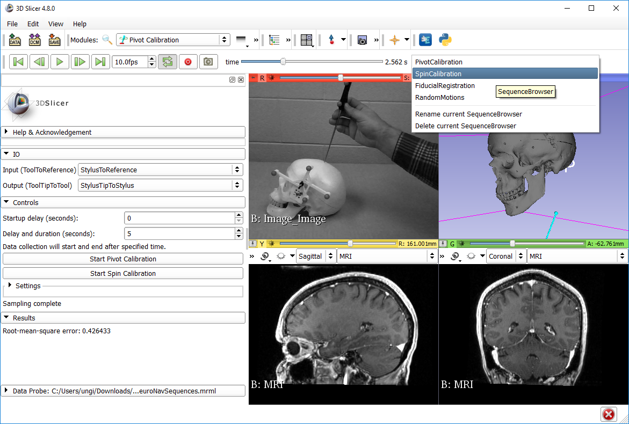
1. pause
2

Slide 27

1. play
3. StylusTip direction remain roughly stationary
2
4. Check RMSE

Slide 28
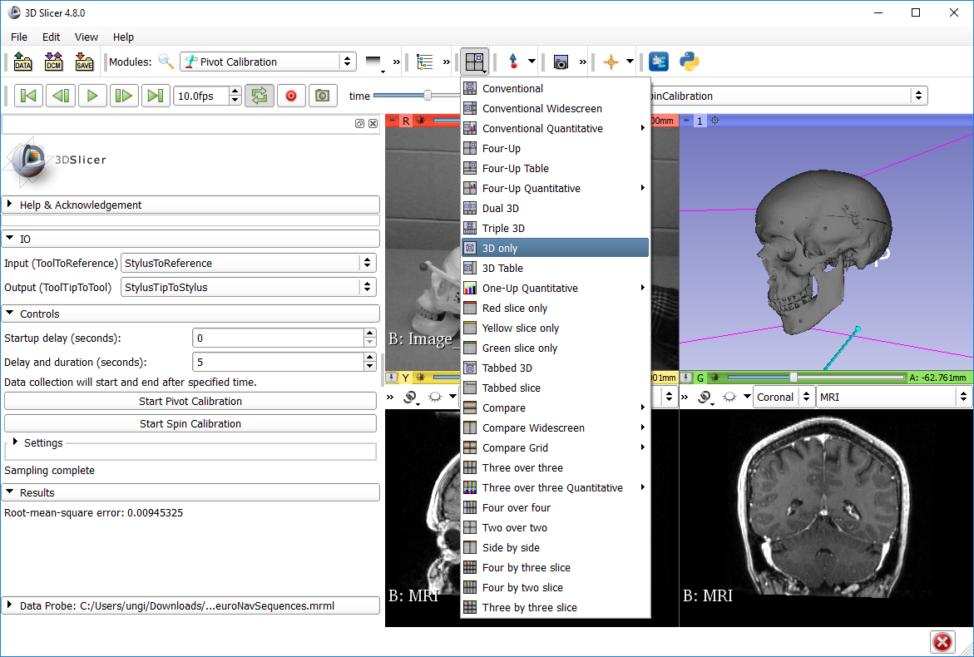
1. pause
1

Slide 29
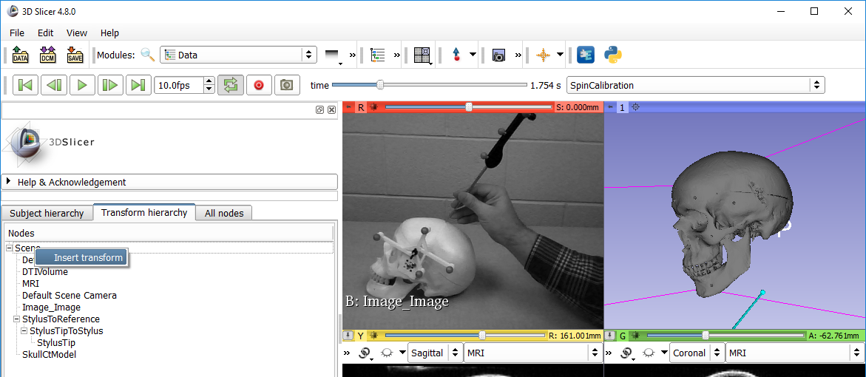
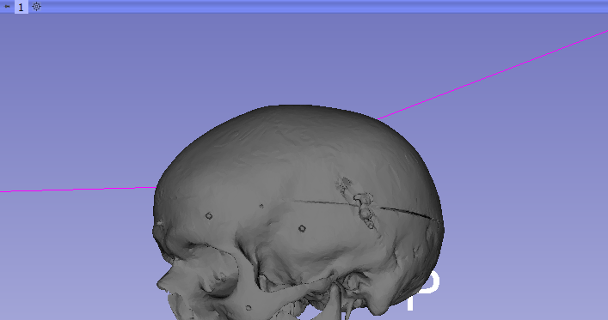
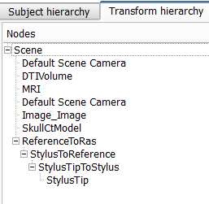
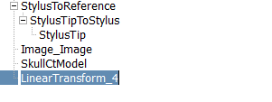
1
2 right-click
3
6. Drag and drop StylusToReference to create this new hierarchy
4. Double-click to rename to “ReferenceToRas”
RAS is the coordinate system of the Slicer views

Slide 30
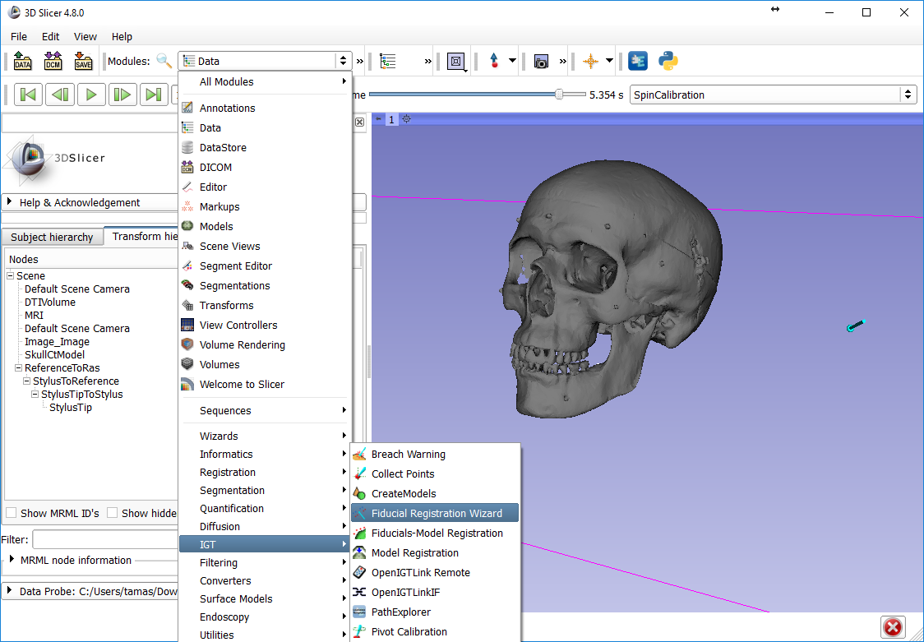
1
3. select
2

Slide 31
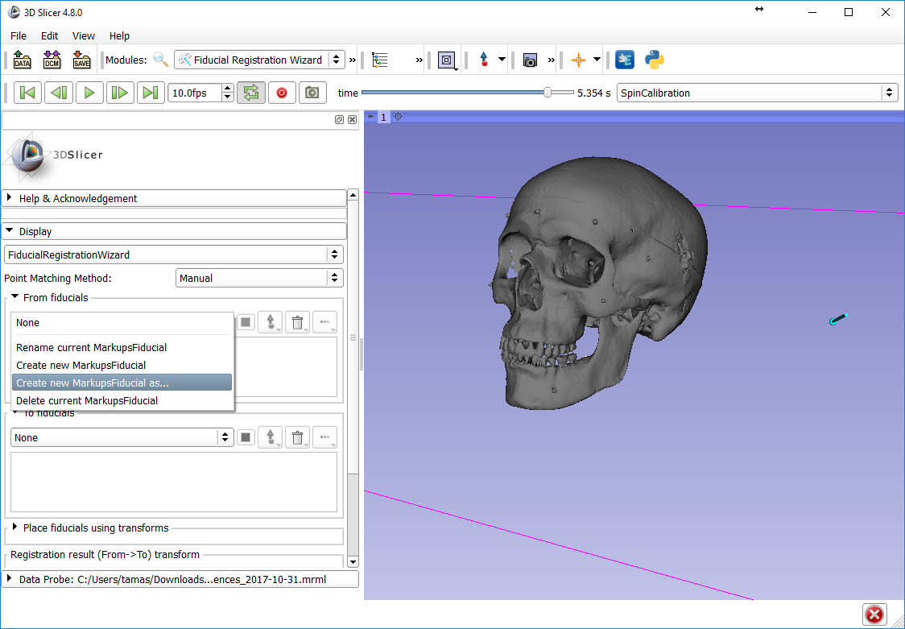
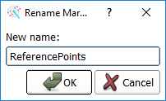
1
2
3
4

Slide 32
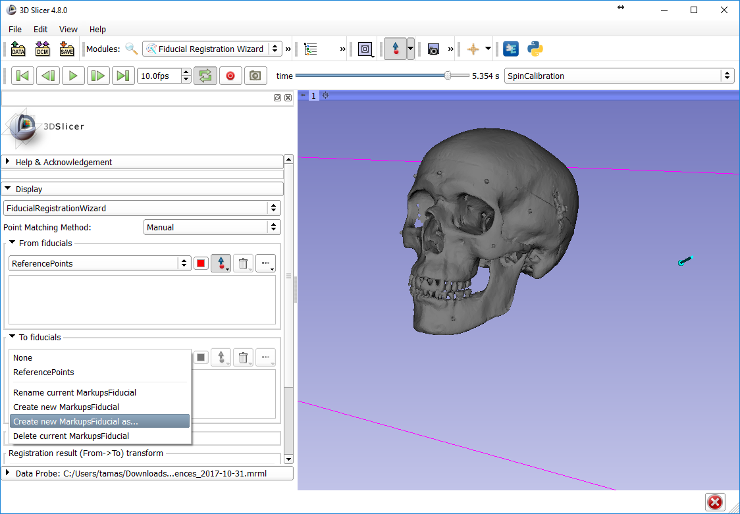
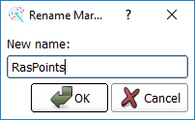
1
3
4
2

Slide 33
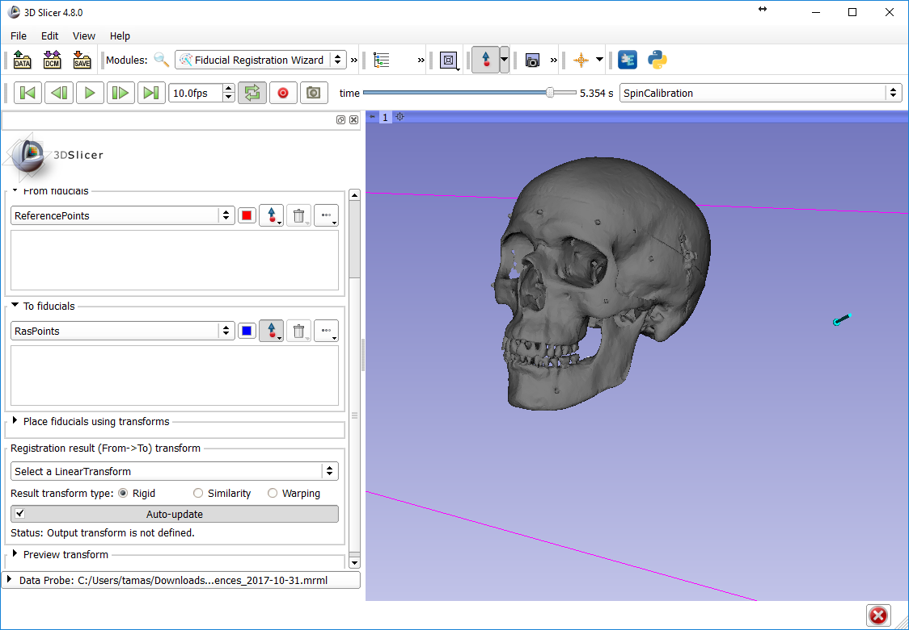
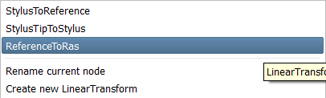
1. Maybe need to scroll down to see “result”
2
3. select ReferenceToRas

Slide 34
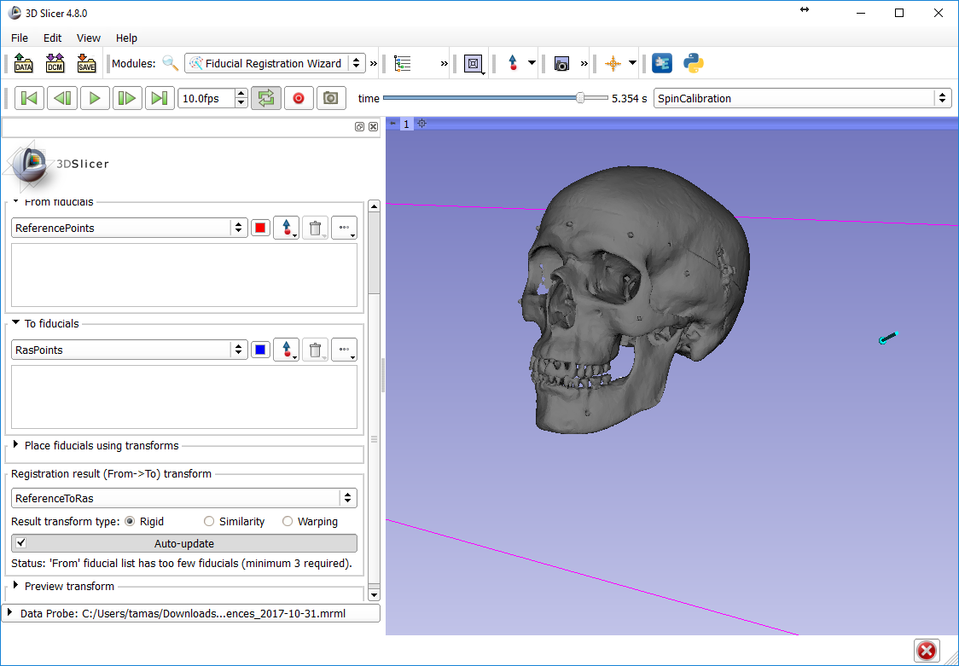
Make sure this button is unchecked when interacting with 3D viewer!
1

Slide 35
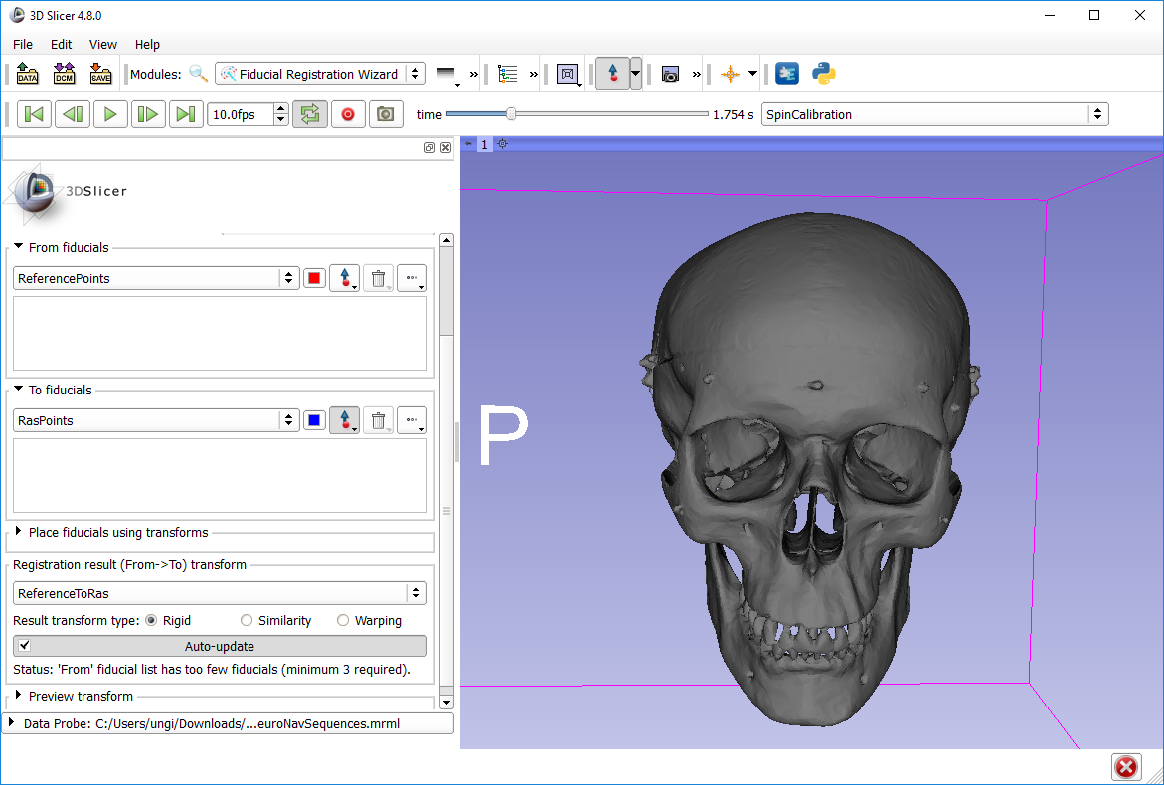
1. Set up 3D viewer like this to see the right side of the skull
2
3. click here

Slide 36
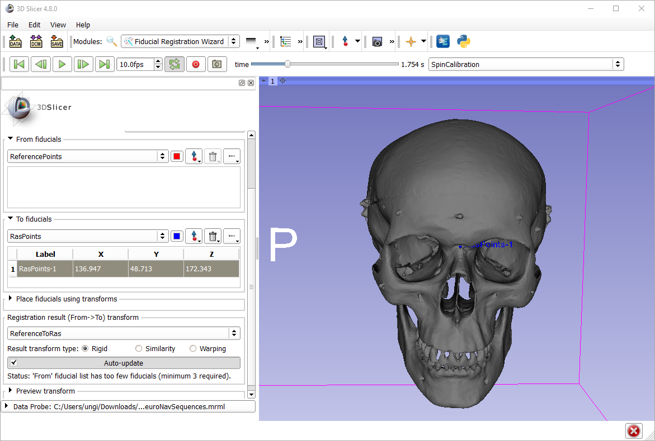
Notice blue point created
Notice point added to list

Slide 37
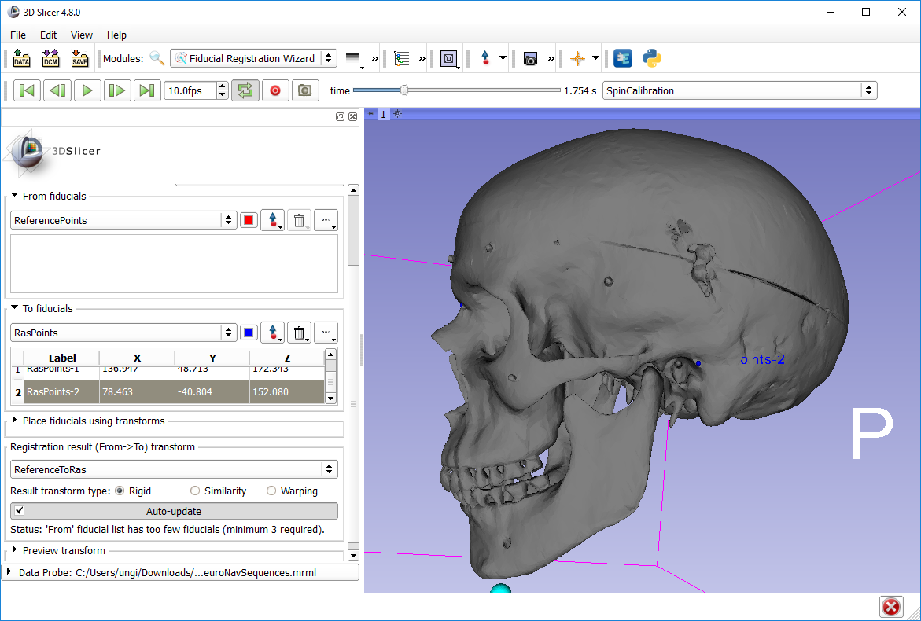
1. Similarly, create the second point here

Slide 38
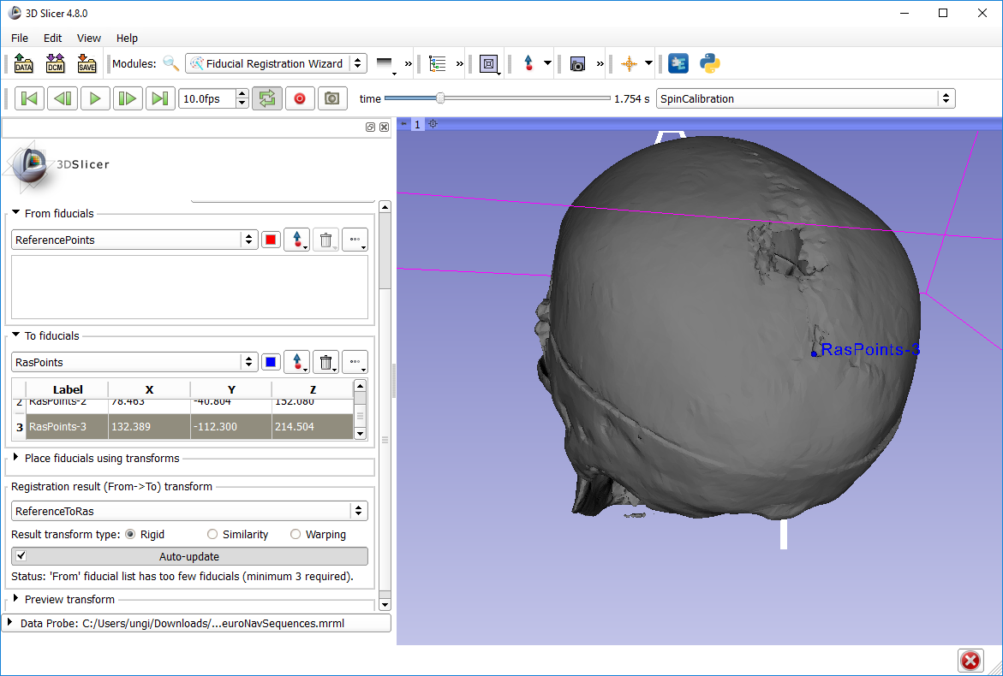
1. And the third one here

Slide 39


Note: When you press Place ‘From’,
a new point will be created in
the From list at the position of the StylusTip
1. Expand Place box
2. Select StylusTipToStylus in upper (From) selector

Slide 40

1

Slide 41

1. Select Four-up

Slide 42

1
Scroll time to the point where the stylus on the video points to the first registration point
3. see
1
2

Slide 43

1
1
3. see
2

Slide 44

1
4. see
1
3. see
2
5. uncheck

Slide 45



Troubleshooting
How to redo one point (before registration completed)
Delete
How to reset registration (after a completed registration)
2. see
1
Very important to reset to Identity before starting a new registration!
3

Slide 46

2. Volume Reslice Driver

Slide 47

1. select yellow driver node

Slide 48

1. select green driver node

Slide 49

4. Move
3
1
2

Slide 50

1
2. select
4. see
4. see
3. scroll down to see this option and check it

Slide 51

1. module history
2. Back to Volume Reslice Driver

Slide 52

These advanced view options are used to set up viewers in a way that navigation is intuitive for the surgeon. E.g. stylus movement to the left results stylus model movement to the left in the viewers
2
3
1

Slide 53

1
2

Slide 54

1
2. click anywhere
3. double-click each coordinate and set to zero

Slide 55

1
2. drag and drop “F” here
Result: overlapping red point

Slide 56

1
2. double-click
3
4

Slide 57

1 double-click
2

Slide 58

Tractography Seeding

Slide 59

4
see result
1
2
3

